Slide 1
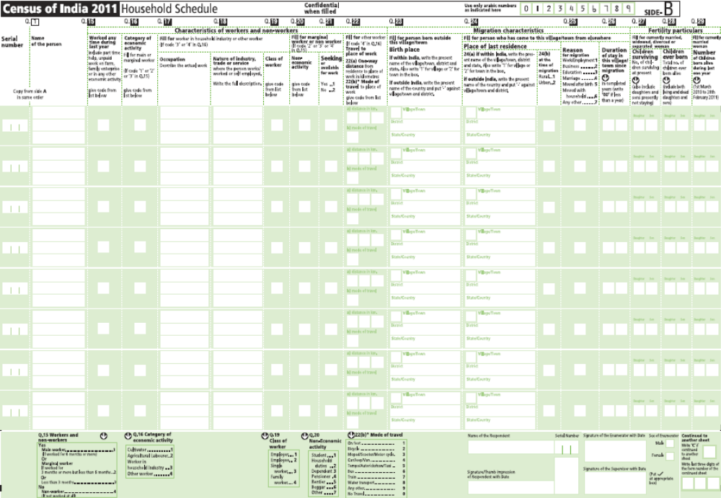
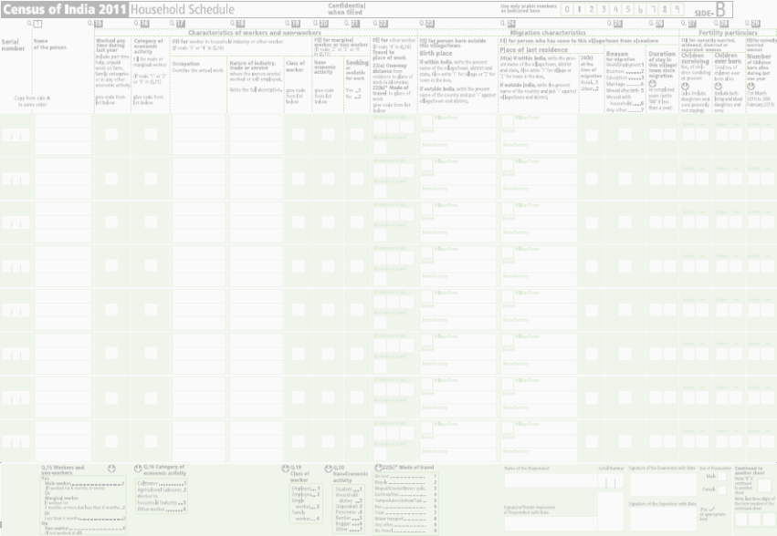



Slide 2



Important
Before you start filling up of Q.15 on Side- B, please Copy the Serial number and Name of the person(Q.1) from the Side-A in the same order in which you have written them on Side – A, in the first two columns of Side –B.
Please note that if the responses to any of the questions 15 - 22 are not to be filled in for a person, put a dash (–). Do not leave these blank.

Slide 3
Introduction to Module 4
Characteristics of Workers and Non-workers
Question 15: Worked any time during last year
Question 16: Category of economic activity
Question 17: Occupation
Question 18: Nature of industry, trade or service
Question 19: Class of Worker
Question 20: Non-economic activity
Question 21: Seeking or available for work
Question 22: Travel to Place of Work

Slide 4
Definition of Work (Economic Activity)
(Para 6.103 to 6.114)
Work may be defined as participation in any economically productive activity with or without compensation, wages or profit.
Participation may be physical and/or mental in nature.
Work involves not only actual work but also includes effective supervision and direction of work.

Slide 5
Definition of Work and Worker
It even includes part time help or unpaid work on farm, family enterprises or in any other economic activity.
The important point to note is that the. activity should be economically productive
Worker: A person who has participated in any economically productive activity at any time during the reference period (one year preceding the date of enumeration).

Slide 6
Reference period for Questions of Work
(Para 6.115)
In Census, for all Questions on Workers and Non-Workers, the reference period is one year preceding the date of enumeration.
All the economic activities pursued by the person during the entire reference period of the preceding one year will be considered.

Slide 7
Persons to be treated as ‘Worker’
(Para 6.101 to 119)
Persons engaged in cultivation and growing of crops (except plantation crops) solely for domestic consumption.
Persons engaged in rearing of animals for production of milk for own use.
Participation of family members as part time helpers or unpaid workers in family cultivation or in family enterprise or in any other economic activity, however insignificant their monetary contribution may appear to be.

Slide 8
Persons to be treated as ‘Worker’contd…
A person who is engaged in some economic activity but at the same time has also attended to some household chores or has attended school/college, etc.
Persons under training such as apprentices, with or without stipends or wages.
Musicians, dancers rope-dancers, acrobats, snake-charmers, jugglers, etc. who perform in public places and earn livelihood out of it.

Slide 9
Persons to be treated as ‘Worker’ contd…
Persons engaged in work such as rice pounding for sale or wages, or in domestic services for wages or minding cattle for wages or selling firewood or making and selling cow dung cakes or selling grass, etc. or any other work like cultivation, etc.
A public or social worker engaged in a public service activity or a political worker engaged in furthering the political activity of her/his party.

Slide 10
Persons to be treated as ‘Non-Workers’
(Para 6.119 B)
A person who was engaged in household duties in her/his own house but does no other economically productive work should be treated as a non-worker.
A person who was a non-worker throughout the reference period, and had been offered work but not joined yet, is a non-worker.

Slide 11
Persons to be treated as ‘Non-Workers’ contd…
Rent receiver or a pensioner or receiver of agricultural or non-agricultural royalty or dividends or interest is a non-worker unless the person was also engaged in some economic activity for part of the year.
Prostitutes and persons engaged in illicit/unlawful activities such as drug trafficking, smuggling, beggars etc. are non-workers.

Slide 12
Important Points
For persons pursuing more than one economic activity during the reference period, the one in which the engagement was for the major part of the period, will determine her/his economic activity.
Women, aged and children may often be classified as Non-Workers or working for durations less than what they actually do. Make special efforts for listing women's and children’s work by asking probing questions.

Slide 13
Important Points….contd.
Period of temporary absence of normally working persons on account of illness, holiday, temporary closure, strike, etc. during the reference period should not be excluded while deciding whether she/he is Main or Marginal Worker and she/he must be treated as engaged in the work for that period.
A person providing some services or producing goods only for domestic consumption of the household is not a worker, even though from her/his point of view the activity is productive.

Slide 14
Important Points….contd.
Person working only on kitchen gardens growing some vegetables, flowers, fruits, etc. purely for domestic consumption should not be treated as a worker.
For an under-trial prisoner enumerated in a jail, record the work she/he was doing before being apprehended. Similarly, for a person temporarily in a hospital or similar institution, record the kind of work she/he was doing before being admitted. But for convicts in a prison /long-term inmates of penal, charitable or mental institutions, the persons’ previous work should not be recorded.

Slide 15
Important Points….contd.
Inmates of penal or charitable or mental institutions, if detained for 6 months or more, should be treated as long term and if they are not engaged in any economic activity, can be treated as non worker (4 in Q 15) and the non-worker category will be ‘Other’ (Q 20). However, if convicts in jails or inmates of charitable / mental institutions, etc. are engaged in economic activities such as carpentry, carpet weaving, vegetable growing, etc. and are paid for the work they are doing in these institutions, record them as workers.

Slide 16
Women, children and aged also work
(Para 6.111 to 6.114)
Certain economic activities in which women, children and aged work may not be reported as such due to
  lack of proper probing on the part of the enumerator
  respondent’s bias.

Slide 17
Women, children and aged also work…contd.
Some of the unreported economic activities….
Help given by women, children and aged during ploughing, sowing, harvesting and collection of farm produce.
Women and children working as agricultural labourer for wages in cash or in kind
Women and children self employed or engaged as unpaid family workers in industries that can be conducted on Household Industry.
(Annexure – VI )

Slide 18
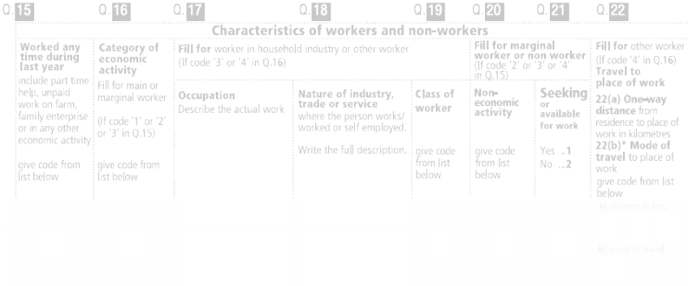
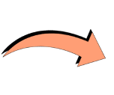
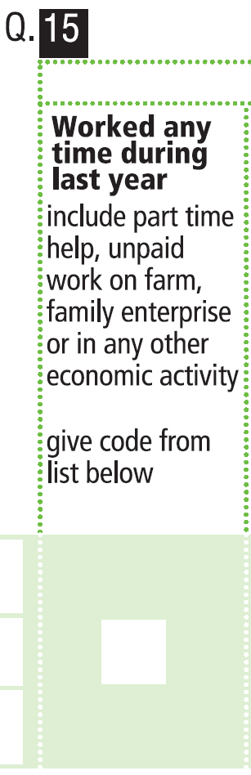
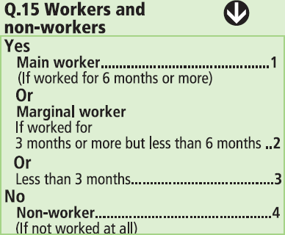

Q. 15: Worked any time during last year
(Para 6.116 to 122)
Includes:
Part time help
Unpaid work on farm
Family enterprise
Or in any other economic activity

Slide 19
Main worker, Marginal worker and Non-worker
Main worker: Person who had ‘worked’ for 6 months or more during the reference period (code 1).
Marginal worker: Person who had ‘worked’ for 3 months or more but less than 6 months (code 2).
Person who had ‘worked’ for less than 3 months (code 3).
Non-worker: Person who did not ‘work’ at all during the reference period (code 4). They will include students, persons engaged in household duties, dependents, pensioners, beggars, etc.

Slide 20


Characteristics of workers and non-workers
All Persons
Yes
Q.15
No
Worker
Non-worker
(Code 4)
6 Months or more
(Code 1)
3 months or more but less than 6 months (Code 2)
Less than 3 months (Code 3)
OR
Main
worker
Marginal
worker

Slide 21
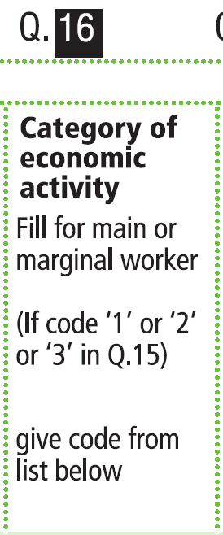
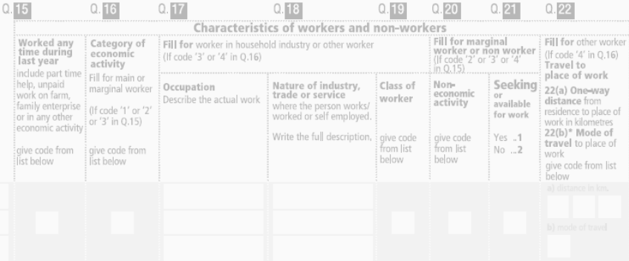
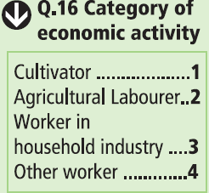
Q.16 : Category of economic activity
(Para 6.123 to 6.127)
For main or marginal workers, if code ‘1’ or ‘2’ Or ‘3’ in Q.15:
Cultivator-1
Agricultural
Labourer-2
Worker in household industry-3
Other worker-4

Slide 22


Characteristics of workers and non-workers
All Persons
Yes
Q.15
No
Worker
Non-worker (Code 4)
6 Months or more
(Code 1)
3 months or more but less than 6 months (Code 2)
Or Less than 3 months (Code 3)
Main
Worker
Marginal
Worker
Q.16
Category of
economic activity
Cultivator………….….1
Agricultural Labourer .2
Worker in HHI………..3
Other worker….…..4

Slide 23
Q 16: Category of economic activity…contd.
This question is only applicable to Main Workers and Marginal Workers (code 1 or 2 or 3 in Question 15)
A person can be classified as a cultivator or as an agricultural labourer only on the basis of the crops grown.
A person engaged in the growing of plantation crops will not be considered as a cultivator or agricultural labourer but recorded as ‘Other Worker’.

Slide 24
Q 16: Category of economic activity…contd.
(Para 6.125 to 6.127)
Cultivator (code 1): A worker who is engaged in cultivation of land owned/held from government or from private person(s) or institution for payment in money, kind or share. Cultivation also includes effective supervision or direction in cultivation.
It does not include plantation crops like tea, coffee, rubber, coconut and betel-nuts (areca).
Read para 6.125 – List of crops for getting classified as a cultivator
Also read para 6.126, 6.127 for details.

Slide 25
Q 16: Category of economic activity…contd.
(Para 6.127)
Agricultural labourer (code 2): A worker who works on another person’s (cultivator’s) land for growing crops* for wages in kind or cash or share.
Agricultural Labourer has no risk in the cultivation, but merely works on another person’s land for wages.
An agricultural labourer has no right of lease or contract on land on which she/he works.
* Crops same as those for getting classified as a cultivator

Slide 26
Q 16: Category of economic activity…contd.
Worker in Household Industry (code 3):
A worker who works in a industry conducted by one or more members of the household at home or within the village in rural areas and only within the precincts of the house where the household lives in urban areas.
Read para 6.127, sub para (i) to (v) in page 74.

Slide 27
Q 16: Category of economic activity…contd.
(Para 6.127)
Other Worker (code 4): All those workers who have been engaged in some economic activity during the last one year, but are not Cultivators or Agricultural Labourers or Workers in Household industry.
Type of workers that come under this category include all government servants, municipal employees, teachers, factory workers, plantation workers, those engaged in trade, commerce, business, transport, banking, mining, construction, political or social work, priests, entertainment artists, etc.
Activities undertaken by the members of the same household not constituting a Household Industry

Slide 28
Characteristics of workers and non-workers
All Persons
Yes
Q.15
No
Worker
Non-worker (Code 4)
6 Months or more
(Code 1)
3 months or more but less than 6 months (Code 2)
Or Less than 3 months (Code 3)
Main
Worker
Marginal
worker
Occupation
Q.16
Q.17
Category of
economic activity
Q.18
Nature of Industry,
trade or service
Cultivator………………1
Agricultural Labourer ..2
Class of worker
Q.19
Employer………………….……1
Employee………………………2
Single worker……………….….3
Family worker……………….…4
Worker in HHI…….…..3
Other worker…..…..4

Slide 29

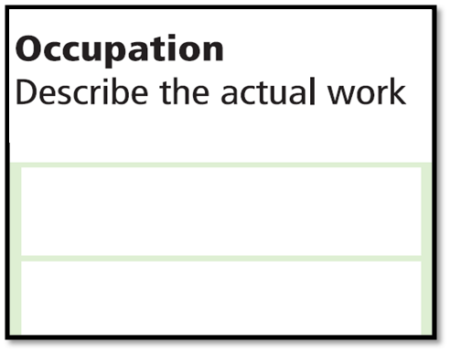

Q. 17: Occupation:
(Para 6.128 to 6.132)
For workers in Hh industry or Other Workers (code 3 or 4 in Q16)
Describe the actual work (in details)
The nature of occupation or the actual work that a person did during the reference period to be recorded.
Description of work would be irrespective of the type of industry, trade or service, etc., in which working.
For self employed, the description of the actual work in which they are engaged will be recorded.
Read para 6.129, 6.130.
For those in defence or similar services record ‘Service’ .

Slide 30

Q. 18: Nature of industry, trade or service: (Para 6.133 to 6.136)
For workers in Hh industry or other workers (code 3 or 4 in Q16)
Where the person works/
worked or self employed
For self employed, the nature of the industry, trade or service will be the one to which her/his actual work recorded under Question 17 relates.
For this question the work place of the person is where she/he is engaged in some economic activity.
How to record in 17 & 18?
See para 6.135 and Examples in Page 73 and Annexure-V.

Slide 31
Q 18: Nature of industry, trade or service…contd.
It is not enough to record `plantation' or `livestock‘ - record whether it is tea plantation or rubber plantation or sheep rearing or cattle breeding.
Not enough to record `manufacturing' or `textile manufacturing‘ - record to indicate whether it is manufacturing of cotton textile in handloom or manufacturing khadi textile or manufacturing silk textile.
Recording mere `trade' is not enough - record as wholesale trading in food grains or pulses or retail trading in spices or grocery and so on.
For those in services, the details such as whether the service belongs to central government, etc. as well as nature of service such as police service may be recorded.

Slide 32


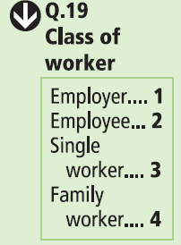
Q.19: Class of Worker:
(Para 6.137 to 6.143)
Excludes workers classified as Cultivators or Agricultural labourer (in Q16)
Employer-1
Employee-2
Single Worker-3
Family Worker-4

Slide 33
Q 19: Class of worker….contd.
Employer (code 1): Who hires one or more persons in her/his work (described under Q17) and does not draw salary.
(Para 6.139)
Employee (code 2): Who does her/his ‘work’ for others for wages or salary in cash or kind.
(Para 6.140)
Single Worker (code 3): Who does her/his ‘work’ by herself/himself without employing others or without the help of family members (except casually) or as a member of co-operative unit.
(Para 6.141)
Family Worker (code 4): Who does her/his ‘work’ in a family enterprise along with other members of the family without wages or salary in cash or kind.
(Para 6.142)

Slide 34
Q 19: Class of worker….contd.
Single worker is a person who works by herself/himself. She/he is not employed by any one else and in turn does not employ anybody else. They include cycle repairer, vegetable seller, those engaged in making of agarbattis or earthenware pottery, etc., who do their work without employing others or without the help of family workers.
Single Worker will include a person who works in joint partnership with one / several persons hiring no employees and also includes a member of a co-operative which is involved in trading, production, processing and services. Each one of the partners /members of such co-operative should be recorded as ‘Single Worker’. Political workers (Members of Parliament, State Legislatures, Local Authorities, Village Panchayat, etc.) and social workers are to be treated as ‘Single Worker’.

Slide 35
Q 19: Class of worker….contd.
A Family Worker is a member of the family who works without receiving wages in cash or kind, in an industry, business, trade or service. For example, the working members in a family of dhobies where they all participate and each does not receive wages separately, will be family workers.
Family Workers may or may not be entitled to a share of the profits in the work or the business carried on either by the person or head of the household or other relative.

Slide 36


Characteristics of workers and non-workers
All Persons
Yes
Q.15
No
Worker
Non-worker (Code 4)
6 Months or more
(Code 1)
3 months or more but less than 6 months (Code 2)
Or Less than 3 months (Code 3)
Main
Worker
Marginal
worker
Marginal
worker
Category of
economic activity
Q.16
Occupation
Non-economic
activity
Q.17
Q.20
Cultivator………..…….1
Agricultural Labourer ..2
Nature of Industry,
trade or service
Student…………….1 Household duties………………2
Dependent…..…....3
Pensioner…………4
Rentier……..……...5
Beggar…………….6
Other………….......7
Q.18
Class of worker
Worker in HHI……..….3
Q.19
Other worker……….....4
Employer……….………1
Employee………………2
Single worker………….3
Family worker…………4
Q.21
Seeking or
Available for work

Slide 37

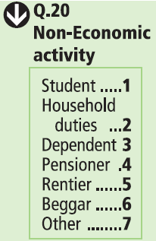

Q.20: Non-economic activity:
(Para 6.144 to 6.165)
To be asked to Marginal workers and Non-workers (code 2,3 or 4 in Q15)
Student–1
Household duties–2
Dependent–3
Pensioner–4
Rentier–5
Beggar–6
Other–7
Certain non-work categories will find priority over other

Slide 38
Q 20: Non-economic activity….contd.
Student (code 1) (para 6.147 to 6.149)
This category will cover all students including those attending part-time classes, correspondence course, attending literacy centres, etc. who are not engaged in any economically productive work. Such Non-Workers will be classified as Students – and code 1 is to be recorded.
For Marginal Workers also who were mainly students during the major part of last year, their non-economic activity will be ‘Student’ (code 1).

Slide 39
Q 20: Non-economic activity….contd.
Household duties (code 2) (para 6.150 to 6.152)
A person who is attending to daily household chores like cooking, cleaning utensils, collecting fire wood, going to market, etc. will be treated as doing household duties.
A housewife who is also a pensioner will be classified as ‘Pensioner’ (code 4) and not under ‘Household duties’.
A beggar also attending to household duties, will be classified as ‘Beggar’ (code 5). A person attending to household duties but also seeking/available for work would be categorised under ‘Other’ (code 6).
Ask probing questions, particularly in the case of women, to find out if they are engaged in any economic activity, apart from household duties.

Slide 40
Q 20: Non-economic activity….contd.
Dependent (code 3) (para 6.153 to 6.155)
Will include all dependents such as infants or children not attending school or persons permanently disabled from work because of illness or old age.
Dependents may include even able-bodied persons who cannot be categorized in any other category of Non-Workers but are dependent on others. However, if such a person who is dependent on others for subsistence but is seeking/available for work, she/he should be categorized as ‘Other’ (code 7).
If a girl or an old woman attends to household duties she should be categorized as doing ‘Household duties’ (code 2) and not ‘Dependent’ (code 3).

Slide 41
Q 20: Non-economic activity….contd.
Pensioner (code 4) (para 6.156, 6.157)
A person drawing pension after retirement from service and is doing no other work, i.e., not employed again in some work or not engaged in some other work such as cultivation, business, trade, etc., will come under this category. Please note that all persons do not receive pension after retirement.
This category will also include persons who receive ‘old age pension’ under some social benefit scheme of the government and persons receiving ‘freedom fighters pension’, etc.
Widows receiving pension after their husband’s death will also fall under this category.

Slide 42
Q 20: Non-economic activity….contd.
Rentier (code 5)
This category includes rentiers or persons living on remittances, agricultural or non-agricultural royalty, interest
or dividend.
Beggar (code 6)
This category will cover beggars and vagrants not engaged in any economically productive work. if any person in this category is also a student, she/he will be classified as ‘Student’ (code 1). Persons in this category may be attending to household duties also, in such cases these persons have to be included under this category (code 6) and not under ‘Household duties’.

Slide 43
Q 20: Non-economic activity….contd.
Other (code 7) (para 6.160 to 6.163)
All Non-Workers and Marginal Workers who may not come under any of the other six categories. Includes convicts in jails or inmates of penal, mental or charitable institutions doing no paid work, persons who are seeking/available for work,
Prostitutes, persons having unidentified source of income and those with unspecified sources of subsistence not engaged in any economically productive work will come under this category.
If any person in this category is also a student, she/he will be classified as ‘Student’ (code 1). For persons under this category and attending to household duties also, they have to be included under this category (code 7) and not under ‘Household duties’.

Slide 44
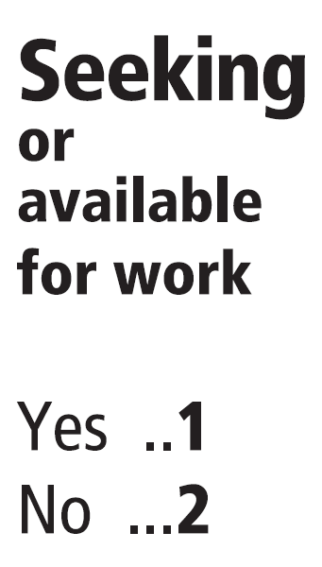
Q.21: Seeking or available for work: (Para 6.166 to 6.168)
To be asked to Marginal workers and Non-workers
(code 2,3 or 4 in Q15)
Yes-1
No-2
For ‘Main’ workers (code 1 in Q15) put a dash ‘-’ here.

Slide 45
Q 21: Seeking or availability for work….contd.
Seeking work - A person may have got herself/himself registered in the employment exchange or may be applying for jobs or may have made other efforts for a job, with a view to applying for a job with the intention to offer herself/himself for employment.
Seeking work is more applicable in urban areas where there are facilities of employment exchanges and greater awareness about availability of jobs.
In rural areas, there may be no facilities of employment exchanges so, the person may be available for work but not actually seeking work. Thus, where there is no formal mechanism of seeking employment, any Marginal Worker or Non-Worker, if available when offered work, will be considered as seeking work.

Slide 46


Characteristics of workers and non-workers
All Persons
Yes
Q.15
No
Worker
Non-worker (Code 4)
6 Months or more
(Code 1)
3 months or more but less than 6 months (Code 2)
Or Less than 3 months (Code 3)
Main
Worker
Marginal
worker
Marginal
worker
Q.22
Category of
economic activity
Q.16
Occupation
Non-economic
activity
Travel to place of work
Q.17
Q.20
Nature of Industry,
trade or service
(a) One way distance from residence to place of work in kilometres
Cultivator………..…….1
Agricultural Labourer ..2
Q.18
Student…………….1 Household duties………………2
Dependent…..…....3
Pensioner…………4
Rentier……..……...5
Beggar…………….6
Other………….......7
Class of worker
(b) Mode of travel to place of work
On foot………..…………….1
Bicycle………………….…..2
Moped/Scooter/Motor cycle.....................................3
Car/Jeep/Van……………...4
Tempo/Autorickshaw/ Taxi………………………...5
Bus…………………………6
Train………………………..7
Water transport….……......8
Any other…………………..9
No travel……….……………...0
Worker in HHI……..….3
Q.19
Other worker……….....4
Employer……….………1
Employee………………2
Single worker………….3
Family worker…………4
Seeking or
Available for work
Q.21

Slide 47
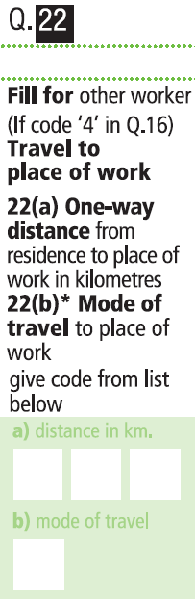
Q.22: Travel to Place of Work:
(Para 6.169 to 6.178)
To be asked to ‘Other Workers’ (code 4 in Q16)
Q.22(a): One way distance from residence to place of work in kilometers
Q22 (b): Mode of travel to place of work

Slide 48
Q 22: Travel to place of work….contd.
If the person was engaged in more than one economic activity during the last year, this question will obviously be asked with reference to the main economic activity (Q 17)
For visitors who qualify to be enumerated in the household, this question will be canvassed with reference to the normal place of residence and the place of work from where she/he has come to live with this household.
For defence and similar paramilitary personnel, these questions are not applicable. In all such cases dashes (-) will be put under Questions 22(a) and 22(b).

Slide 49
Q 22 (a): One way distance from residence to
place of work in kms. (para 6.171 to 6.175)
For peddlers/persons who have no fixed place of work, distance will be the one from residence to the nearest point of the area of operation. If there are two different areas of operation - area which is farthest to be considered.
For persons commuting to more than one place for work, farthest place from the residence will be considered.
Person commuting to different places on different days- place gone more frequently will be considered.
If a person has to use more than one mode of travel to reach the place of work from residence, the distance travelled by each of these modes will have to be added in order to arrive at the distance to the place of work.
If the place of work is same as the place of residence, ‘000’ will be entered.

Slide 50
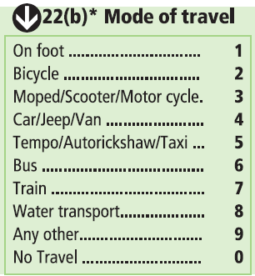
Q.22 (b): Mode of travel to place of work
(Para 6.176 to 6.178)
On Foot-1
Bicycle-2
Moped/Scooter/Motor cycle-3
Car/Jeep/Van-4
Tempo/Autorickshaw/Taxi-5
Bus-6
Train-7
Water Transport-8
Any other-9
No Travel-0

Slide 51
Q 22 (b): Mode of travel to place of work….contd.
If the person has to use more than one mode of travel to reach her/his work place, the mode accounting for the longest distance will be considered to record the information under this question.
Code 9 - 'Any Other’, will include mode of travel not covered by codes ‘1’ to ‘8’. These could be rickshaw, tonga, cart, tractor trolley, etc., owned or hired to reach the place of work.
If the main economic activity of the person is carried on at her/his own place of residence i.e., she/he has not to travel to undertake her/his economic activity, code ‘0’ will be entered under this question.

Slide 52
